Slide 1
The Future – Wylfa Newydd
Jacob Home, Operations Engineer
Generation Department

Slide 2
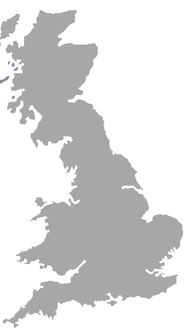
Horizon overview
Established 2009
Acquired by Hitachi November 2012
Advanced Boiling Water Reactor technology
Provide at least 5.4GW of new capacity across two sites - c.10 million homes
Expect first unit at Wylfa to be operating in the first half of the 2020s
c.£20billion investment in the UK
Over 320 staff at Gloucester HQ and 30 at local Wylfa office
Wylfa Newydd
Gloucester HQ
Oldbury

Slide 3
Corporate structure
Hitachi Power Systems Company
Hitachi Nuclear Systems Division
Hitachi Global Nuclear Business Division
Developer, owner, operator 100% owned by Hitachi
ABWR reactor provider
‘Delivery Team’ lead
80.01% Hitachi, 19.99% GE
Contractual relationship

Slide 4
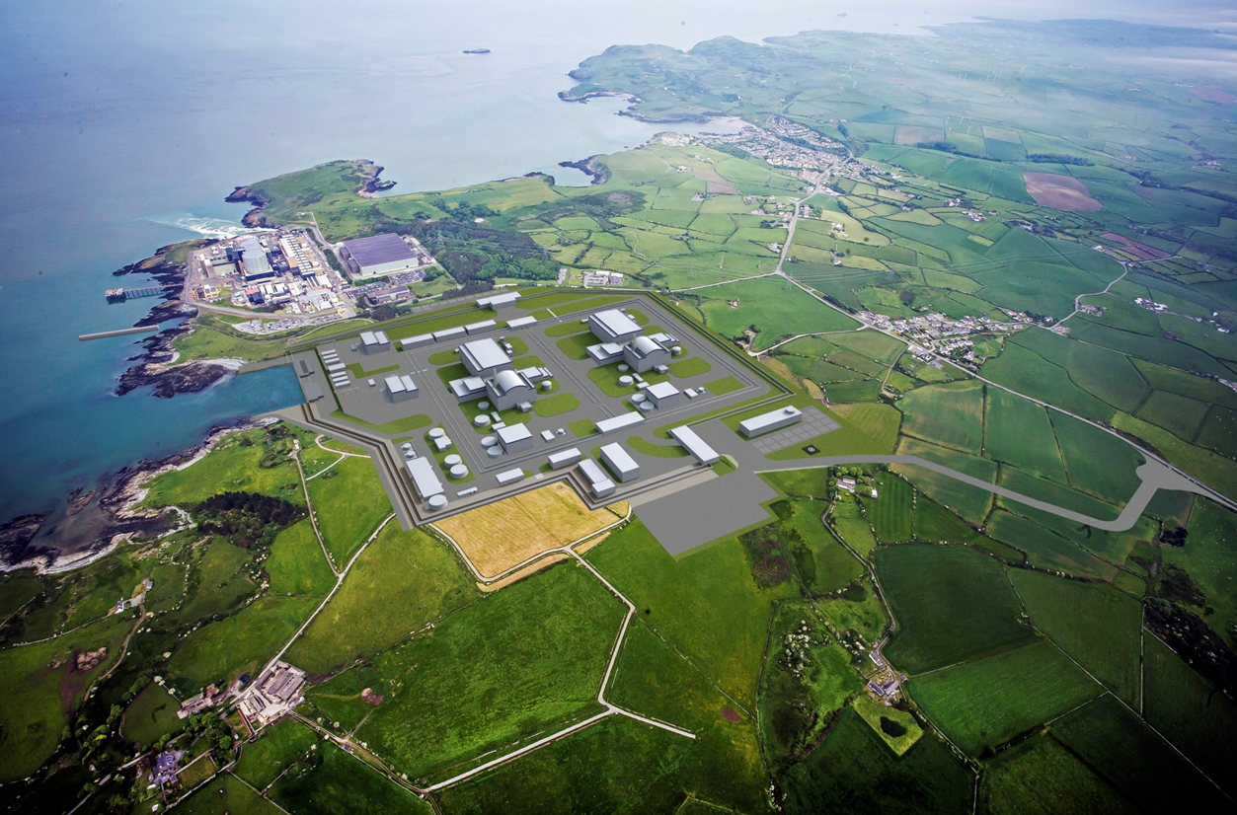
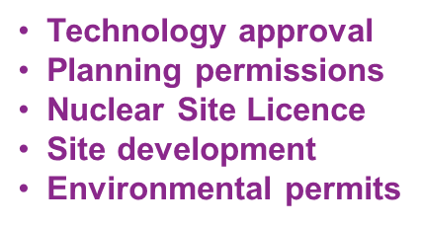
Delivering Wylfa Newydd

Slide 5
Baseline Schedule
Current priority is to complete the design and engineering, and major permissions, licences and commercial agreements to enable site preparation to commence from mid-2018.
Site Licence Grant Q2-18
GDA Completion Dec-17
First Nuclear Construction 2020
Development Construction Operation
Final Investment Decision Q2-19
Contract for Difference agreed Q3-18
Unit 1 Commercial Operation, first half of the 2020s

Slide 6
Look Ahead FY15/16
Community engagement
- Open surgeries, Project Liaison Group, newsletters
Apprenticeship schemes
- Horizon supports Cwmni Prentis Menai and will be launching the Horizon apprenticeship scheme in 2016
Engaging with the supply chain
- Opportunities for local services and regional will continue to grow
Pre Application Consultation 2
- Due this winter
On-going site investigations
- Archaeological and detailed offshore
Generic Design Assessment
Step 3 close to completion
Step 4 due to start

Slide 7
60 years of operation at Wylfa Newydd
Operational life of at least 60 years
Entire station employee complement will be up to 850
Up to an additional 1000 staff during outage periods
Continue our strategic approach to training, development and skills
Benefit to the local and regional economy
Strong links with education and academia (e.g. NI, IMechE, ICE, IET)
Good neighbour in a partnership with the local community

Slide 8
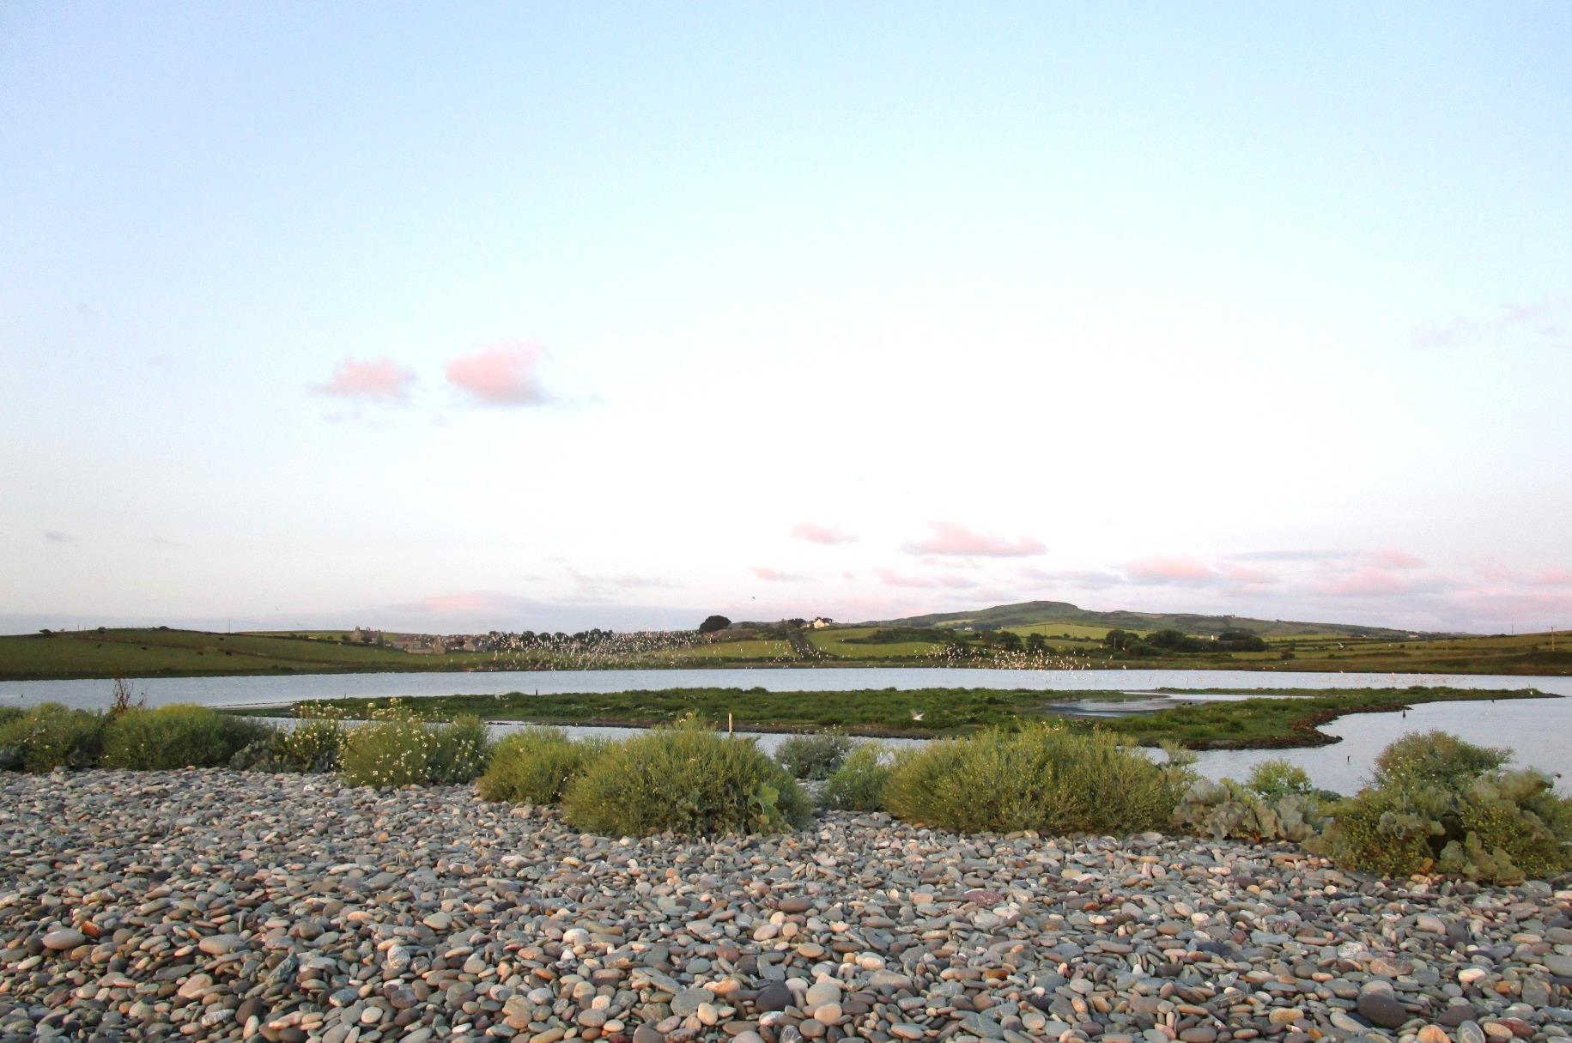
For more information
Horizon Nuclear Power channel
@HorizonNuclear
www.horizonnuclearpower.com
Diolch yn fawr iawn

Slide 9
Operational staffing*
Function | Approximate Split | Example Roles
Operations | 25 % | Control Room Operators, Field Operators.
Engineering | 25 % | Mechanical, Electrical, Control and Instrumentation, Nuclear.
Maintenance | 25 % | Control and Instrumentation, Electrical, Mechanical.
Business Support | 8 % | HR, Finance, Procurement, Administration, Stores.
Technical Support | 10 % | Health Physics, Chemistry, Reactor Physics, Environmental Science, Industrial Safety, Emergency Preparedness.
Training | 7 % | Training Instructors, Simulator Instructors, Administration.
* Indicative only

